Slide 1
procedure-Oriented (Structured) programming vs Object-oriented programming
Md. Kowsar Hossain (AUVI)

Slide 2
Procedure-Oriented programming
A problem is viewed as a sequence of tasks.
A number of functions are written to accomplish these tasks.
COBOL, FORTRAN, C etc.
Writing a program to
Add, sub, multiply two numbers.
MAIN PROGRAM
FUNCTION 1
FUNCTION 2
FUNCTION 3
FUNCTION 4
FUNCTION 5

Slide 3
Procedure-Oriented programming
MAIN PROGRAM
GLOBAL DATA
FUNCTION 1
FUNCTION 2
FUNCTION 3
FUNCTION 4
FUNCTION 5
Functions operate on data.
Primary focus is on functions.
Drawbacks:
No data security for global data.
Does not model real world problems very well.

Slide 4
Characteristics of Procedure-Oriented programming
Emphasis is on doing things (algorithms).
Large programs are divided into functions.
Most of the functions share global data.
Data move openly around the system from function to function.
Employ top-down approach in program design.

Slide 5
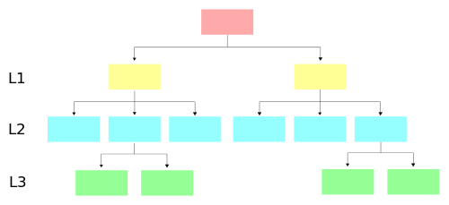
Top-down approach
A single module will be split into several smaller modules.
General to specific.

Slide 6

Real world problems
Attributes:
Name
Age
Height
…..
Functions:
Walking
Driving
……
Sheldon

Slide 7

Real world problems
Attributes:
Name
Age
Height
…..
Functions:
Walking
Driving
……
Attributes:
Name
Fuel
speed
…..
Functions:
setFule
setSpeed
beDriven
……
Sheldon
Sedan

Slide 8

Real world problems
Attributes:
Name
Age
Height
…..
Functions:
Walking
Driving
……
Attributes:
Name
Fuel
speed
…..
Functions:
setFule
setSpeed
beDriven
……
Sheldon
Sedan
Sheldon is driving his Sedan

Slide 9
Real world problems
A
B
Sheldon is driving his Sedan from A to B

Slide 10

Real world problems
Penny
Leonard
Amy
Sheldon
Class: person

Slide 11

Real world problems
Class: person
Attributes:
Name
Age
Height
…..
Functions:
Walking
Driving
……
Class: Blueprint of object

Slide 12

Real world problems
Object: Sheldon
Class: person
Object: Amy

Slide 13
Object-Oriented programming
Object 1
Object 2
communication
Data
Data
Function
Function
Object 3
Data
Function
Allows decomposition of a problem into a number of entities called object.
Builds data and functions around these objects.
Data of an object can be accessed only by the function associated with the object and protects it from accidental modification from outside functions.
Function of one object can communication with the function of other object.
C++, Java etc.

Slide 14
Characteristics of Object-Oriented Programming
Emphasis is on data rather than procedure.
Programs are divided into objects.
Data is hidden and can not be accessed by external functions.
Object may communicate with each other through functions.
Follows bottom-up approach.

Slide 15
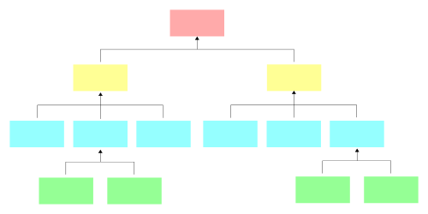
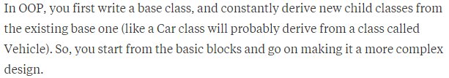
Bottom-up approach
Lot of small modules will be grouped to form a single large module.
Specific to general.

Slide 16
How Procedure-oriented Programming Looks at a Problem
Procedures/functions
Procedures act on data
Program
Data
Procedure
Procedure

Slide 17
How Object-Oriented Programming Looks at a Problem?
Objects
Data
Methods (functions)
Methods surround the data and protect data from other objects
Method
Method
Data
Method
Method
OBJECT

Slide 18
Basic concepts of Object-Oriented Programming
Objects.
Classes.
Encapsulation and data abstraction.
Inheritance.
Polymorphism.
Dynamic binding.
Message passing.

Slide 19
A simple program
Input: name and age of a person.
Output: display name and age of that person.

Slide 20
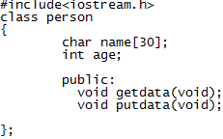
A simple program
keyword
Attributes
By default “private”
Functions/methods

Slide 21
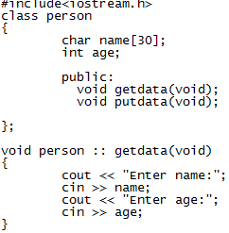
A simple program
Header file
Scope resolution operator
Insertion or put to operator/ bit-wise left-shift
Extraction or get from operator

Slide 22
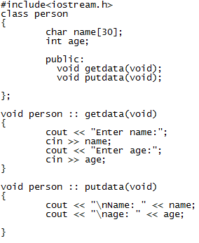
A simple program

Slide 23
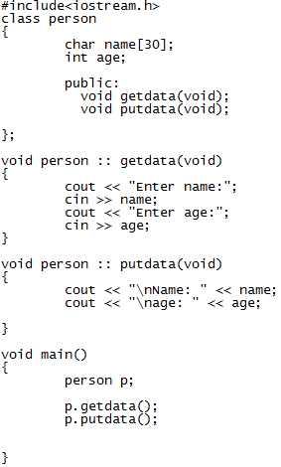
A simple program
dot operator

Slide 24
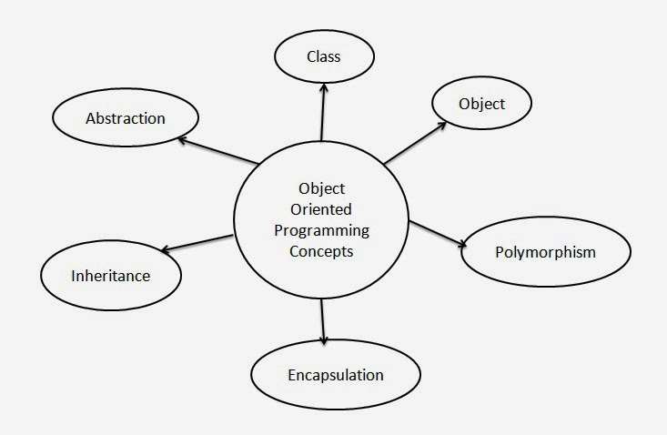
Basic concepts of Object-Oriented Programming

Slide 25
Objects
Can be concrete and tangible entities.
Sheldon, amy, book, car, laptop etc..
Can be abstract entities and do not have to be tangible.
Database, email, webpage, song etc..
An object can contain other objects
House = kitchen + bedrooms + …
Laptop = keyboard + display + processor + …

Slide 26
Objects’ three properties
Unique identity – name, serial number, relationship with another object ..
Set of attributes – location, speed, size, name, phone number …
Behaviors (action)– walking, driving, take picture, send email …
Behavior
Attributes

Slide 27
classes
Describe the commonalities of similar objects.
Person : sheldon, leonard, amy, panny ..
Car : sedan, ford, toyota ...
Classroom : CSE 101, CSE 102 …
Building: CSE, EEE, CE, ME …
Blueprint of object.
Describe both the attributes and the behaviors
Person: name, age .. + sleep, walk ..
User-defined data types and behave like the built-in types.
Fruit mango;

Slide 28

Encapsulation
The wrapping up of data and functions into a single unit is known as encapsulation.
Data is not accessible to the outside world.
Only those functions which are wrapped in the class can access it.
This insulation of the data from direct access by the program is known as ‘data hiding’ or ‘information hiding’.

Slide 29
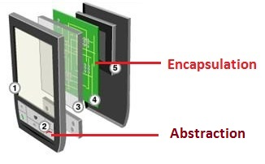
Abstraction
Representing essential features without including the background details or explanations.

Slide 30
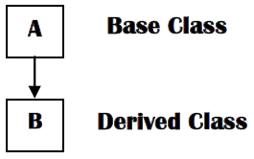
Inheritance
A process by which objects of one class acquire the properties of objects of another class.
Provides the idea of reusability.
Inherited class is called parent/base/super class.
Class that inherits parent class is known as child/derived/sub class.
vehicle
wheeled vehicle
boat

Slide 31
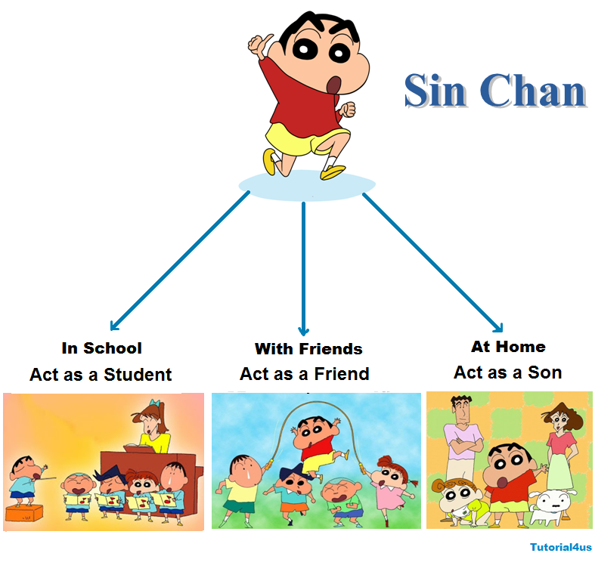
Polymorphism
Poly - many and morph – form(behavior).
An operation may exhibit different behavior in different instances.

Slide 32
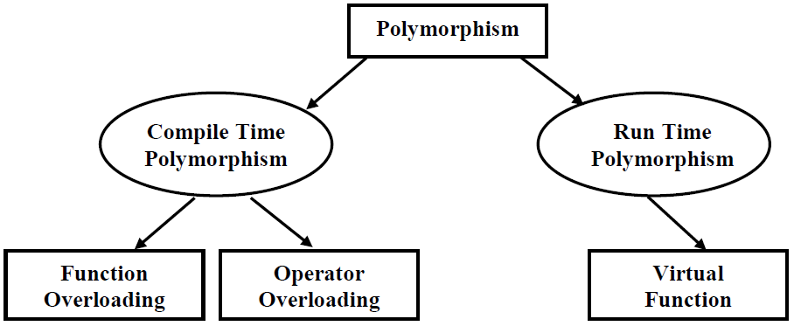
Polymorphism

Slide 33
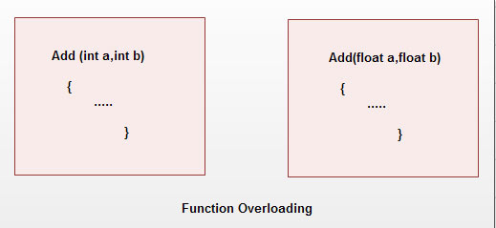
Function overloading

Slide 34
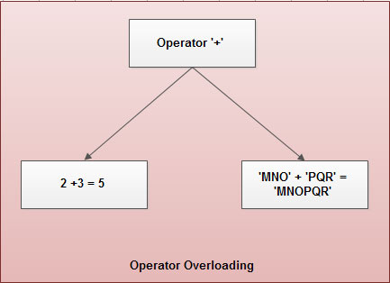
Operator overloading

Slide 35
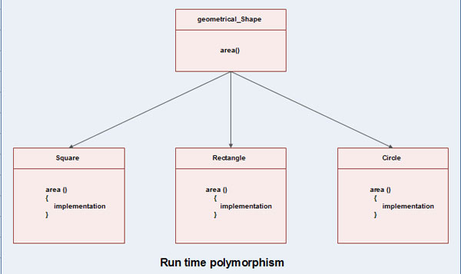
Virtual function

Slide 36
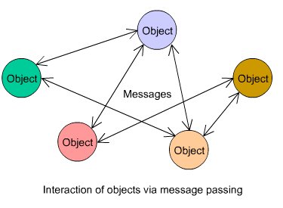
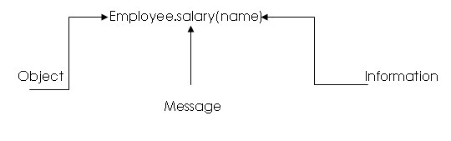
Message passing

Slide 37
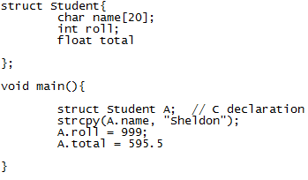
Structure in C
By default public

Slide 38
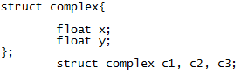
Limitations of C structure
struct data type can not be treated like built-in data type.
c3 = c1 + c2; is illegal.
Do not permit data hiding because all the structure members are public members.

Slide 39
Structure in C++
The only difference between a structure and a class in C++ :
By default, the members of a class are private.
By default, the members of a class are public.

Slide 40
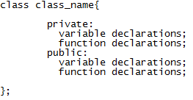
Specifying a class
Class members:
Functions – member functions.
Variables – data members.
Visibility labels:
Private – can be accessed only from within the class.
Public – can be accessed from outside of the class also.
Protected – used in inheritance.

Slide 41
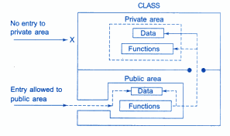
Specifying a class
Only the member functions can have access to the private data members and private functions.

Slide 42
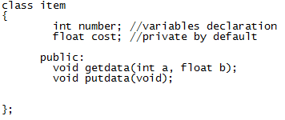
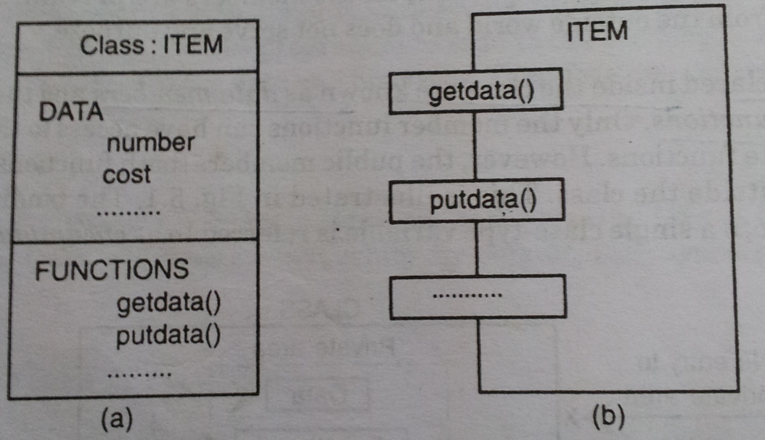
Simple class example and its representation
Representation of a class

Slide 43
Creating objects
Once a class has been declared, we can create variables of that type by using the class name.
item X ; // memory for X is created
It creates a variable of of type item. In c++ the class variables are known as objects. Therefore X is called an object of type item.
Objects can also be created when a class is defined by placing their names immediately after the closing brace as we do in the case of structures. For e.g.-
class item
{ --------
------------ } x,y,z;
But usually we declare the objects close to the place where they are used & not at the time of class definition.

Slide 44
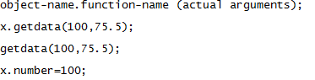
Accessing class members
item x;
legal
illegal
illegal

Slide 45
Defining member functions
Outside the class definition.
Inside the class definition.

Slide 46
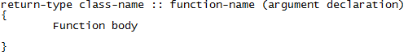
Outside the class definition

Slide 47
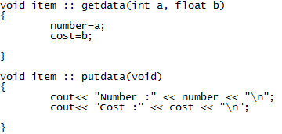
Outside the class definition
Membership label

Slide 48
Characteristics of member function
Several different classes can use the same function name. The ‘membership label’ will resolve their scope.
Member function can access the private data of the class. A non-member function (except friend function) can not do so.
A member function can call another member function directly without using dot operator.

Slide 49
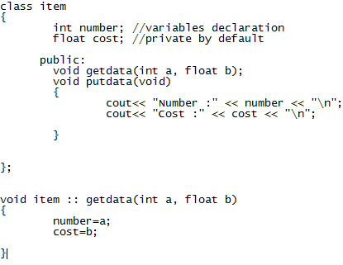
Inside the class definition
When a function is defined inside of a class, it is treated as an inline function.

Slide 50
Inline function
Function is used to save memory space.
Do not need to write the same code again and again.
When function is called, it takes a lot of extra time for-
Jumping to the function.
Saving registers.
Pushing function arguments into the stack.
Returning to the calling function.
When a function is small, a substantial percentage of execution time may be spent in such overheads.
One solution is using inline function.

Slide 51
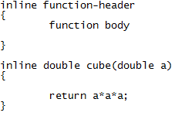
Inline function
Compiler replaces the function call with the corresponding function code.
The speed benefits of inline functions diminish as the function grows in size.
The functions are made inline when they are small enough (one or two lines).
No inline function in java.
// redundant use of inline
The above style is considered as a bad programming style

Slide 52
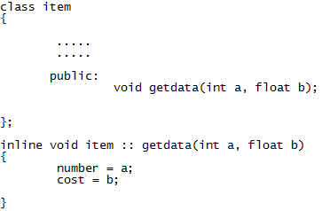
Making an outside function inline

Slide 53
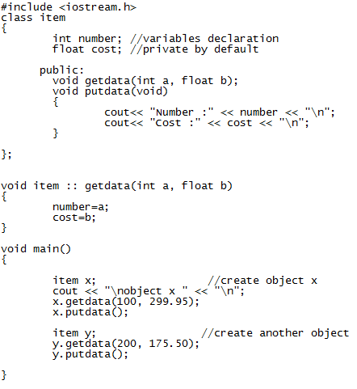
C++ program with class

Slide 54
C++ program with class

Slide 55
C++ program with class

Slide 56
C++ program with class

Slide 57
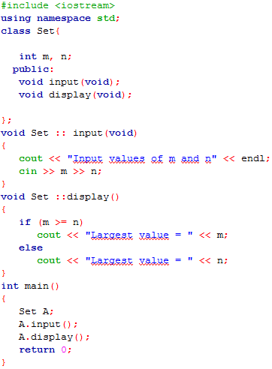
Nesting of member functions

Slide 58
Nesting of member functions

Slide 59
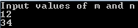
Nesting of member functions

Slide 60
Nesting of member functions

Slide 61
Nesting of member functions

Slide 62
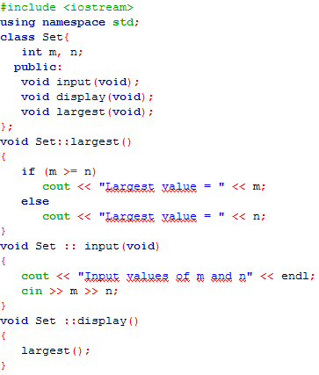
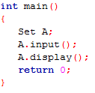
Nesting of member functions

Slide 63
Nesting of member functions

Slide 64
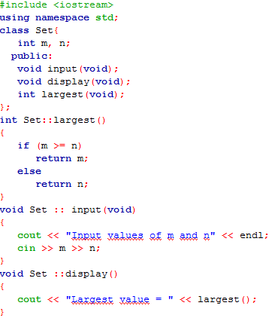
Nesting of member functions

Slide 65
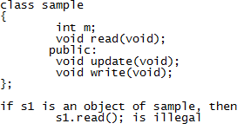
Private member functions

Slide 66
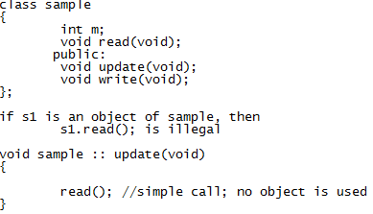
Private member functions
Delete an account in a customer file.
Provide increment to an employee.

Slide 67
Why do we need private variables?
A public member can be accessed from outside the class, which for practical considerations means "potentially anywhere". If something goes wrong with a public field, the culprit can be anywhere, and so in order to track down the bug, you may have to look at quite a lot of code.A private member, by contrast, can only be accessed from inside the same class, so if something goes wrong with that, there is usually only one source file to look at. If you have a million lines of code in your project, but your classes are kept small, this can reduce your bug tracking effort by a factor of 1000.

Slide 68
Why do we need private variables?
Another advantage is related to the concept of 'coupling'. A public member m of a class A that is used by another class B introduces a dependency: if you change m in A, you also have to check usages of m in B. Worse yet, nothing in class A tells you where m is being used, so again you have to search through the entire codebase;

Slide 69
Why do we need private variables?
Private variables help prevent people from depending on certain parts of your code. For example, say you want to implement some data structure. You want users of your data structure to not care how you implemented it, but rather just use the implementation through your well defined interface. The reason is that if no one is depending on your implementation, you can change it whenever you want. For example, you can change the back-end implementation to improve performance. Any other developers who depended on your implementations will break, while the interface users will be fine. Having the flexibility to change implementations without effecting the class users is a huge benefit that using private variables (and more broadly, encapsulation) gives you.

Slide 70
Why do we need private variables?
Make everything private by default, and then expose only those parts that absolutely have to be public. The more you can make private, the better.

Slide 71
why to make function private in class?
You should make a function private when you don't need other objects or classes to access the function, when you'll be invoking it from within the class.

Slide 72
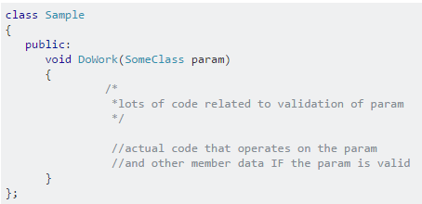
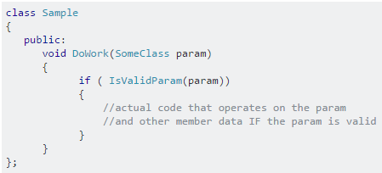
why to make function private in class?

Slide 73
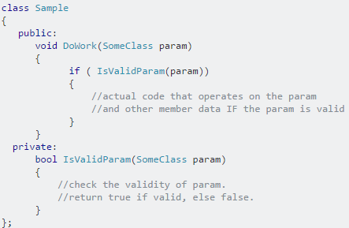
why to make function private in class?

Slide 74
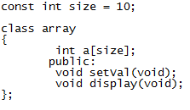
Arrays within a class

Slide 75
Memory allocation for objects
Member functions are created and placed in the memory space only once when they are defined as a part of a class specification, since all the objects belonging to that class use the same member functions.
Only space for member variables is allocated separately for each object when the object is declared.

Slide 76
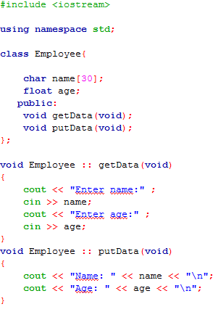
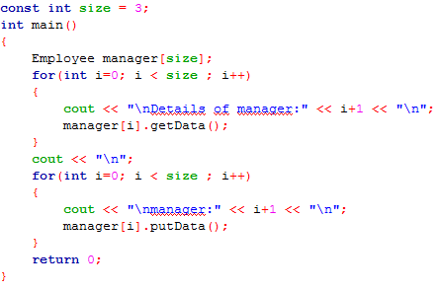
Arrays of Objects

Slide 77
Arrays of Objects

Slide 78
Arrays of Objects

Slide 79
Objects as function arguments
An object may be used as a function argument.
A copy of the entire object is passed to the function (pass-by-value).
Only the address of the object is transferred to the function (pass-by-reference).

Slide 80
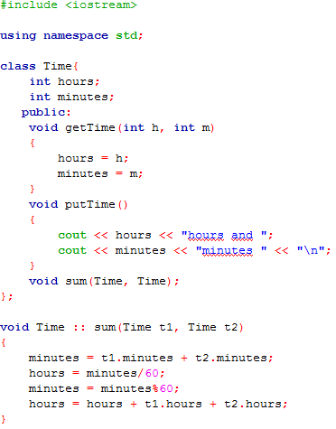
Objects as function arguments

Slide 81
Objects as function arguments

Slide 82
Objects as function arguments

Slide 83
Objects as function arguments

Slide 84
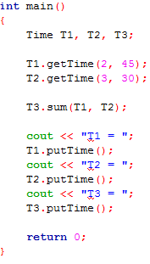
Objects as function arguments

Slide 85
Objects as function arguments

Slide 86
Objects as function arguments

Slide 87
Objects as function arguments

Slide 88
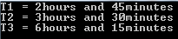
Objects as function arguments

Slide 89
Friendly functions
A non-member function cannot have an access to the private data of a class.
However, there could be a situation where two classes share a particular function.
Manager and scientist class use income_tax function.
Income_tax function can be made friendly with both the classes.
The function declaration should be preceded by the keyword friend.
Functions declared with the keyword friend are known as friend functions.
Friend function has the full access rights to the private members of the class.
A function can be declared as friend in any number of classes.

Slide 90
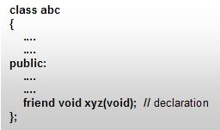
Friendly functions

Slide 91
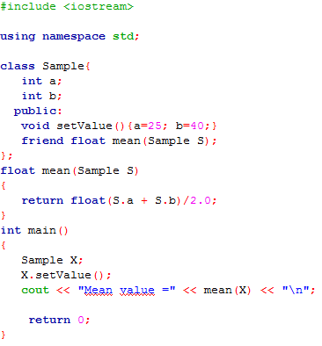
Friendly functions

Slide 92
Friendly functions

Slide 93
Friendly functions

Slide 94
Friendly functions

Slide 95
Friendly functions

Slide 96
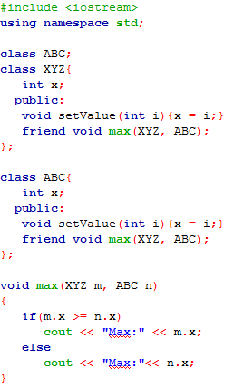
A function friendly to two classes
Forward declaration

Slide 97
A function friendly to two classes

Slide 98
A function friendly to two classes

Slide 99
A function friendly to two classes

Slide 100
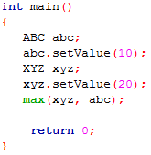
A function friendly to two classes

Slide 101
A function friendly to two classes

Slide 102
A function friendly to two classes

Slide 103
A function friendly to two classes

Slide 104
A function friendly to two classes

Slide 105
A function friendly to two classes

Slide 106
Characteristics of a friend function
It is not in the scope of the class to which it has been declared as friend.
Since it is not in the scope of the class, it cannot be called using the object of that class.
It can be invoked like a normal function without the help of any object.
Unlike member functions, it cannot access the member names directly and has to use an object name and dot membership operator with each member name (e.g. A.x).
It can be declared either in the public or the private part of a class without affecting its meaning.
Usually, it has the objects as arguments.

Slide 107
Friend function in Java
Java does not have the friend keyword.

Slide 108


Swapping private data of classes

Slide 109
Swapping private data of classes

Slide 110
Swapping private data of classes

Slide 111
Swapping private data of classes

Slide 112
Swapping private data of classes

Slide 113
Swapping private data of classes

Slide 114
Swapping private data of classes

Slide 115
Swapping private data of classes

Slide 116
Swapping private data of classes

Slide 117

Swapping private data of classes

Slide 118
Swapping private data of classes

Slide 119
Swapping private data of classes

Slide 120

Swapping private data of classes

Slide 121


Returning objects

Slide 122
Returning objects

Slide 123
Returning objects

Slide 124

Returning objects

Slide 125

Friendly functions

Slide 126

Friendly functions

Slide 127

Friend class

Slide 128
Friend class

Slide 129
Friend class

Slide 130
Friend class

Slide 131

Friend class

Slide 132
Friend class

Slide 133
Friend class

Slide 134
Friend class

Slide 135
Friend class

Slide 136

Friend class

Slide 137

Friend class

Slide 138
Constructor
A special member function whose task is to initialize the objects of its class.
Special – name is same as class name.
It is invoked whenever an object of its associated class is created.
It is called constructor because it constructs the values of data members of the class.

Slide 139

Constructor
Creates int1 and initializes its data members m and n to zero

Slide 140
Constructor
If a normal member function is defined for zero initialization, we would need to invoke this function for each of the objects separately.
This is inconvenient for a large number of objects.

Slide 141
Default constructor
A constructor that accepts no parameters is called the default constructor.
Default constructor for class A is A::A().
If no constructor is defined, then the compiler supplies a default constructor.
A a; -- invokes the default constructor of the compiler to create the object a.

Slide 142
Special characteristics
Should be declared in the public section.
Automatically invoked when the objects are created.
No return types, not even void and therefore cannot return values.
Cannot be inherited, though a derived class can call the base class constructor.
They can have default arguments.
Constructors cannot be virtual.
Make implicit call to the operators new and delete when allocation is required.

Slide 143

Parameterized constructors

Slide 144

Parameterized constructors
Explicit call
Implicit call – shorthand method

Slide 145


Parameterized constructors

Slide 146

Parameterized constructors

Slide 147

Parameterized constructors
Inline function

Slide 148

Parameterized constructors
Parameter can be of any type except that of the class to which it belongs

Slide 149

Parameterized constructors
Can accept a reference to its own class as a parameter – copy constructor

Slide 150

Function overloading

Slide 151
Function overloading

Slide 152


Multiple constructor in a class (overloaded constructors)

Slide 153
Multiple constructor in a class (overloaded constructors)

Slide 154
Multiple constructor in a class (overloaded constructors)
copy constructor

Slide 155

Multiple constructor in a class (overloaded constructors)

Slide 156

Multiple constructor in a class (overloaded constructors)

Slide 157

Multiple constructor in a class (overloaded constructors)

Slide 158
Multiple constructor in a class (overloaded constructors)

Slide 159
Multiple constructor in a class (overloaded constructors)

Slide 160
Multiple constructor in a class (overloaded constructors)

Slide 161

Multiple constructor in a class (overloaded constructors)

Slide 162
Multiple constructor in a class (overloaded constructors)

Slide 163
Multiple constructor in a class (overloaded constructors)

Slide 164
Multiple constructor in a class (overloaded constructors)

Slide 165
Multiple constructor in a class (overloaded constructors)

Slide 166

Multiple constructor in a class (overloaded constructors)

Slide 167
Multiple constructor in a class (overloaded constructors)

Slide 168
Constructors with default arguments
Complex(float real, float imag =0);
Complex C(5.0);
Complex C(2.0, 3.0);

Slide 169
Default constructor vs Default argument constructor
Default constructor : A::A();
Default argument constructor : A::A(int i=0)
When default argument constructor is called with no arguments, it becomes a default constructor.
when both these forms are used in a class, it causes ambiguity for a statement – A a;
The ambiguity is whether to ‘call’ A::A() or A::A(int i=0).

Slide 170

Default constructor vs Default argument constructor

Slide 171
Dynamic initialization of objects
The initial value of an object may be provided during run time.

Slide 172

Dynamic initialization of objects

Slide 173
Dynamic initialization of objects

Slide 174
Dynamic initialization of objects

Slide 175

Dynamic initialization of objects

Slide 176
Dynamic initialization of objects

Slide 177
Dynamic initialization of objects

Slide 178
Dynamic initialization of objects

Slide 179
Dynamic initialization of objects

Slide 180
Dynamic initialization of objects

Slide 181
Copy constructor
Used to declare and initialize an object from another object.
Integer I2(I1);
Integer I2 = I1;
I2 = I1; (does not invoke the copy constructor rather simply assigns the value of I1 to I2)

Slide 182


Copy constructor

Slide 183
Copy constructor
Copy constructor

Slide 184
Copy constructor
Copy constructor

Slide 185
Copy constructor
Overloaded assignment operator

Slide 186

Copy constructor

Slide 187


What will be the output and why?

Slide 188
References
“Object oriented programming with C++” – E balagurusamy, second edition.
http://www.cplusplus.com/doc/tutorial/inheritance/
Web.

